Slide 1
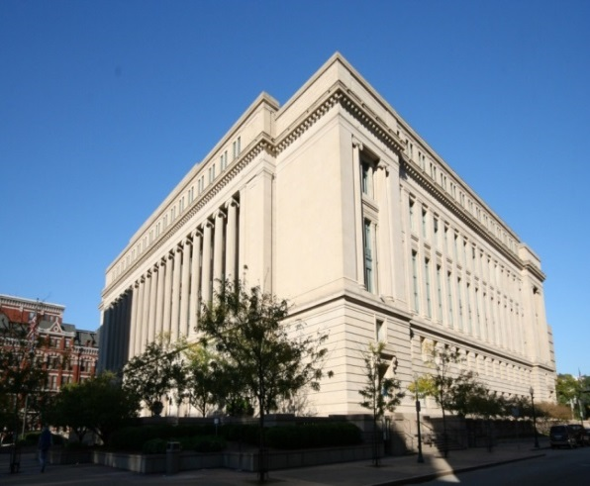
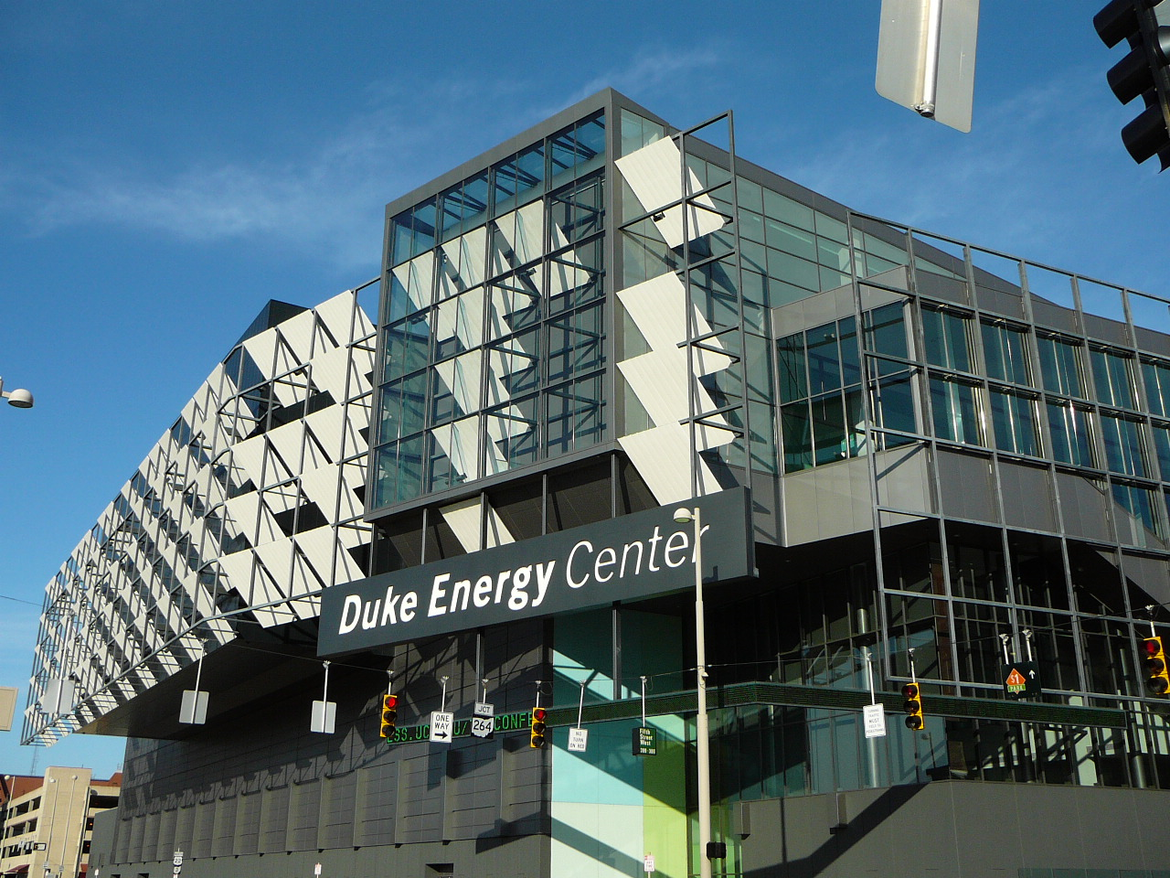
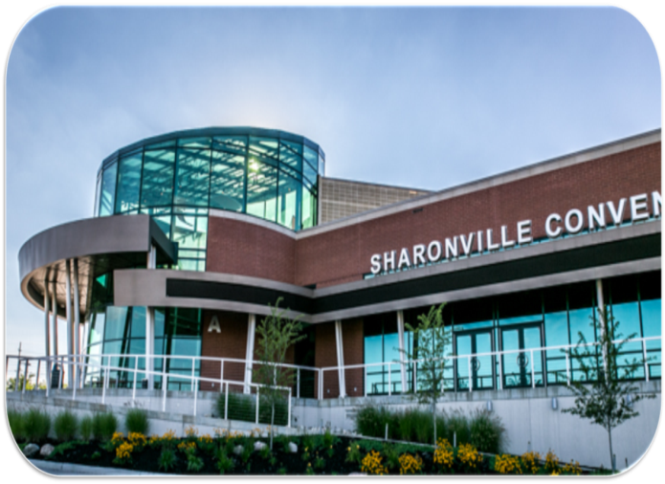
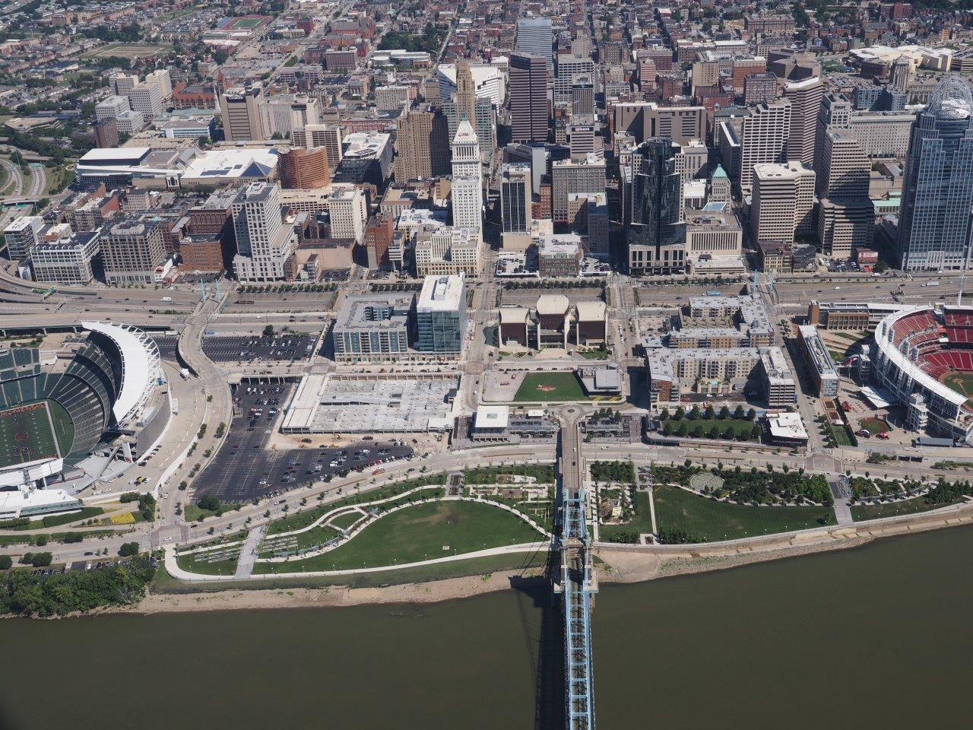
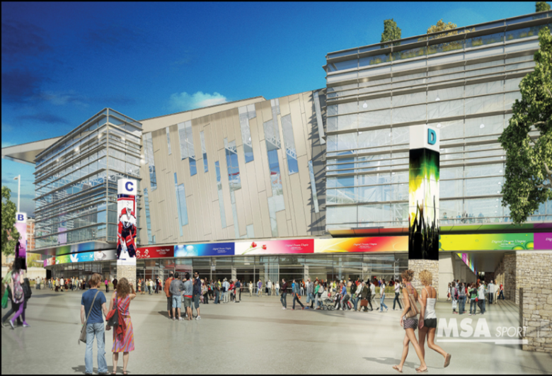
Public Input:
Capital Projects

Slide 2
Capital Project Needs, Obligations, and Requests
Transportation Initiatives
City / County Joint Ventures
Brent Spence Rehab and Replacement
Intermodal Transit System
OKI Regional Freight Plan
Hamilton County Initiatives
Multi-State Initiatives
The Banks / FWW
Museum Center Renovation / Restoration
Duke Energy Convention Center Expansion
Sharonville Convention Center
Western Hills Viaduct
County Facilities
Crime Lab
Deferred Maintenance
Sustain Reds & Bengals Stadia
USS Cincinnati–Veterans Memorial
Justice Center
Privately Driven Partnerships
Publicly Driven Partnerships
FC Cincinnati Stadium
US Bank Arena
AeroHub / GE Evendale
Cincinnati Gardens
Montgomery Gateway
Gibson Greeting Card
Sara Lee / Kahn’s

Slide 3
Public Input Session Agenda
Presentation of capital project needs, obligations and requests
Maintain capital obligations and mandates
Invest to grow the economy, create jobs, improve livability
Funding options
Public Input

Slide 4
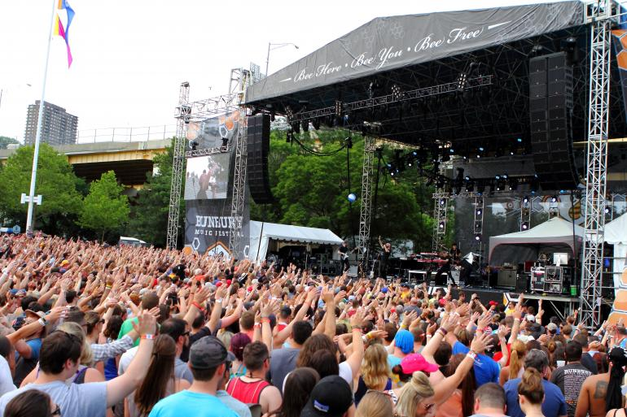
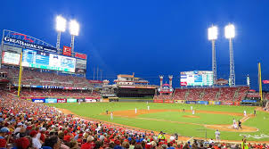
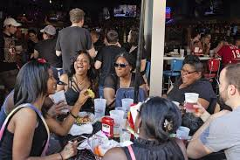
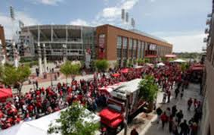
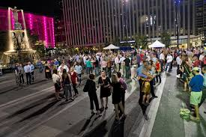
Why Invest in Capital Projects?

Slide 5
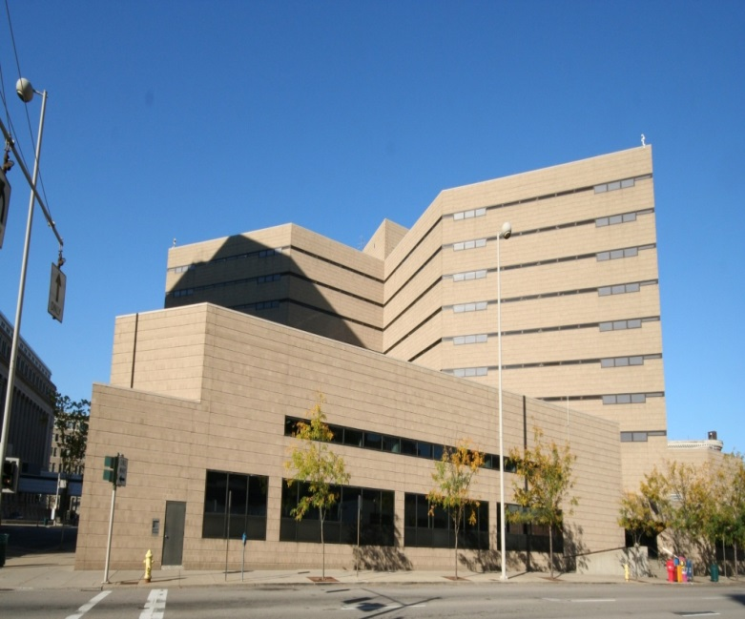
Maintain Critical County Infrastructure
Five-Year Deferred Maintenance Cost |  |  | $ 160,000,000
Ten-Year Deferred Maintenance Cost (cumulative) |  |  | $ 266,000,000
 | Project (20 year cumulative) |  | Project Cost
 | Justice Center |  | $ 151,000,000
 | Justice Center - overcrowding mitigation |  | TBD
 | Courthouse |  | $ 104,900,000
 | 800 Broadway Building |  | $ 94,400,000
 | Alms & Doepke (JFS) Building |  | $ 74,000,000
 | County Administration Building |  | $ 57,400,000
 | William Howard Taft Law Center |  | $ 50,700,000
 | Juvenile Youth Center |  | $ 33,600,000
 | 250 William Howard Taft Rd Building |  | $ 18,500,000
 | Patrol Headquarters |  | $ 13,400,000
 | Communications Center |  | $ 11,000,000
 | Records Center |  | $ 5,400,000
 | Planning & Development Garage |  | $ 4,100,000

Slide 6
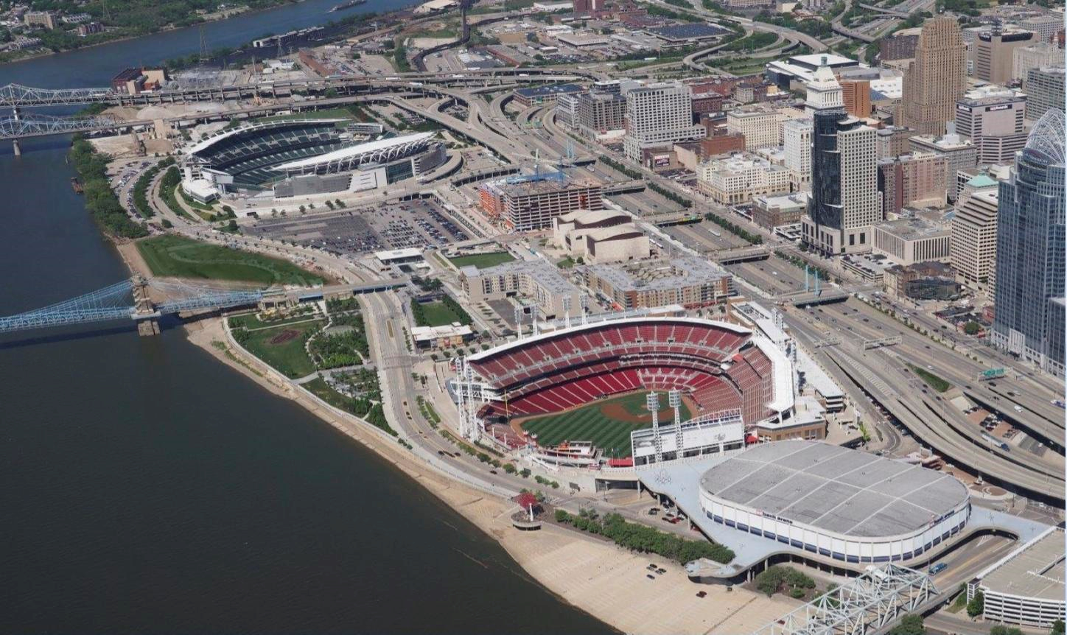
Maintain Reds and Bengals Stadia
Development Summary:
Sustain County’s investment in Great American Ball Park and Paul Brown Stadium
Project Participants:
Public/Private
Project Repair and Replacement Costs:
$205 million
Potential Funding Sources:
Hamilton County Stadia Sales Tax
Economic Impact:
$296 million operations annually (1996 Economic Impact Study)
Development Timeline:
2017-2050

Slide 7
City / County Joint Ventures
Project | Project Cost |  | Potential Economic Impact |  | Potential Funding Sources |  | ROI - generated revenues for County Services
Duke Energy / Cincinnati Convention Center Expansion | $ 230,000,000 |  | TBD |  | Dedicated 3.5% TOT Federal, state, and local public financing, private investment, tax incentives |  | Sales tax Transient occupancy tax
Sharonville Convention Center Expansion | $ 10,000,000 |  | TBD |  | Dedicated 3.5% TOT Federal, state, and local public financing, private investment, tax incentives |  | Sales tax Transient occupancy tax
Western Hills Viaduct | $ 335,000,000 |  | TBD |  | Federal and state grants and funds: TIFIA, TIGER, OKI, ODOT; local license tax fee; private funding through a P3
THE BANKS Phase III-A / Block 24 | $ 2,700,000 (parking facility related) |  | TBD |  | City/County funding; TIF revenue; Federal and state grants; Sales tax; Parking revenue (potential private investment of $85 -100 million) |  | TIF revenue Property tax – long term Sales tax Transient occupancy tax Parking revenue
THE BANKS Phase III-B / Blocks 23, 25, 27 & 28 | $ 58,000,000 (parking infrastructure) |  | TBD |  | City/County funding; TIF revenue; Federal and state grants; Sales tax; Parking revenue (potential $25 million additional park development) |  | TIF revenue Property tax – long term Sales tax Transient occupancy tax Parking revenue
THE BANKS Phase IV / Blocks 1 & 13 | $ 43,000,000 (parking infrastructure) |  | TBD |  | City/County funding; TIF revenue; Federal and state grants; Sales tax; Parking revenue |  | TIF revenue Property tax – long term Sales tax Transient occupancy tax Parking revenue
THE BANKS Ft. Washington Way Decks Note: Direct and indirect economic impact at The Banks to date - $1.0 billion. | $ 100,000,000 |  | TBD |  | Federal and state grants and funds: TIFIA, TIGER, OKI, ODOT; local license tax fee; private funding through a P3 |  | TIF revenue Property tax – long term Sales tax Transient occupancy tax

Slide 8
Expand Convention Centers

Slide 9
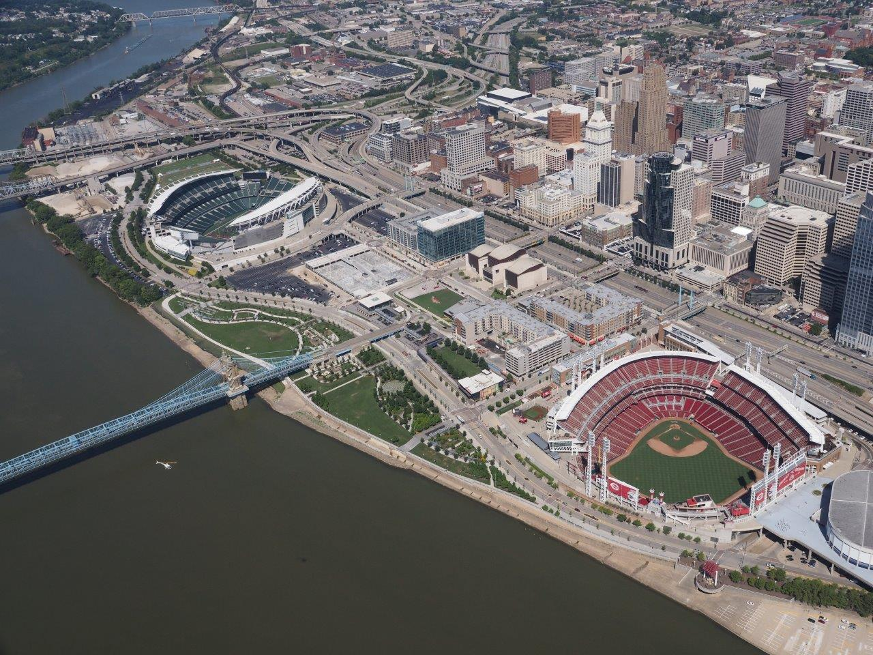
Transform The Banks

Slide 10
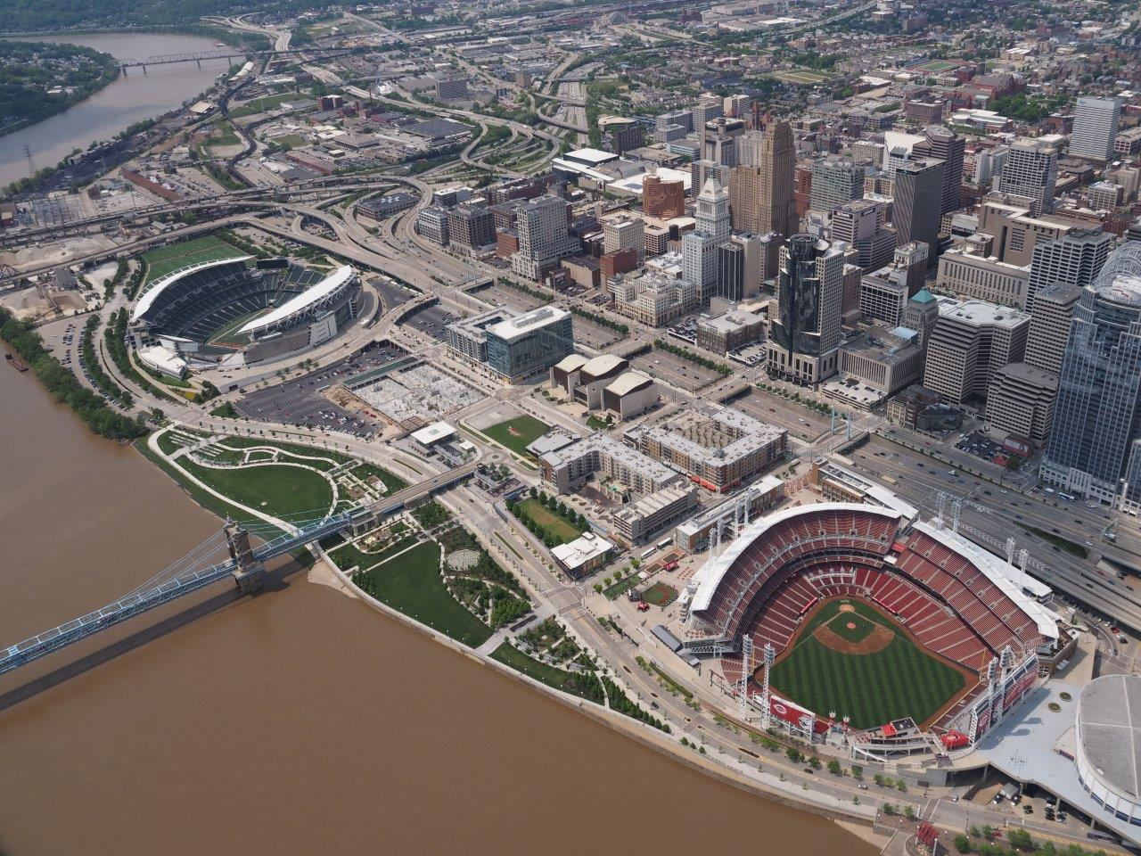
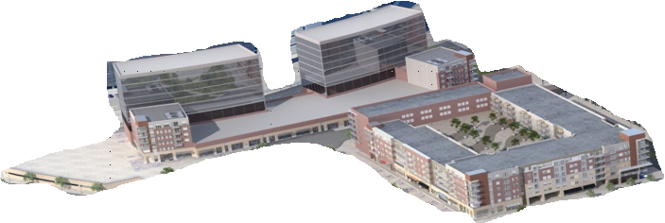
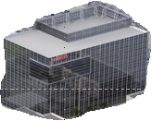
Complete The Banks Master Plan
Paul Brown Stadium
Phase IV
Ft. Washington Way Decks
Phase III
Park
Phase I Office
Great American Ball Park
Sustainability of Riverfront

Slide 11
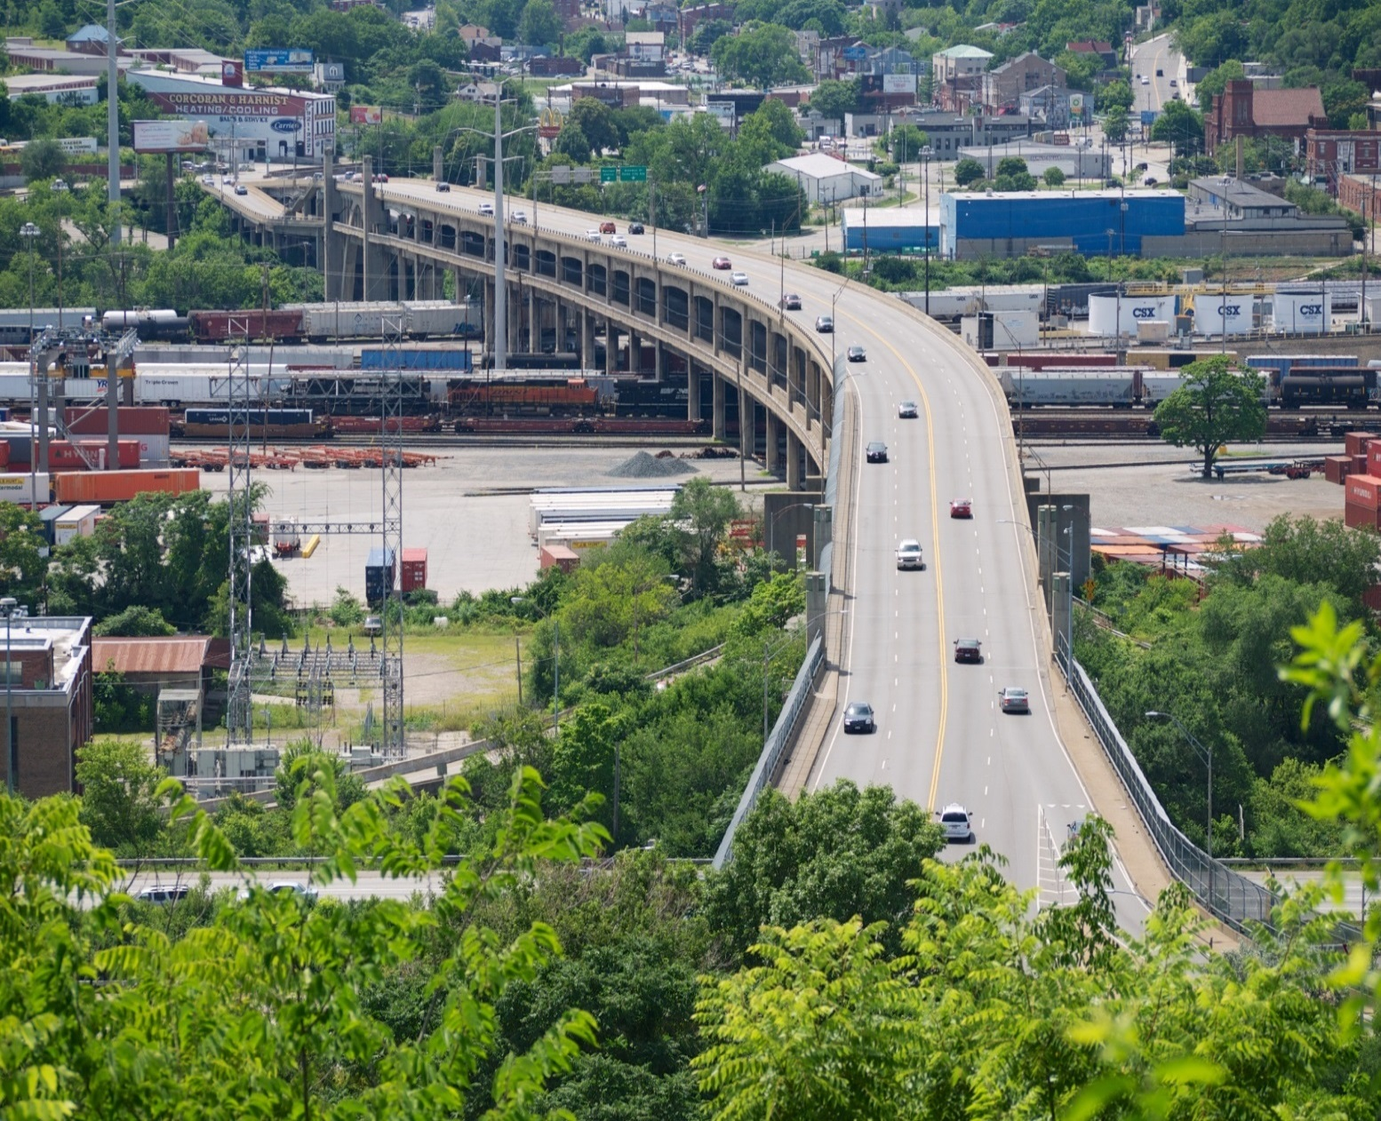
Western Hills Viaduct

Slide 12
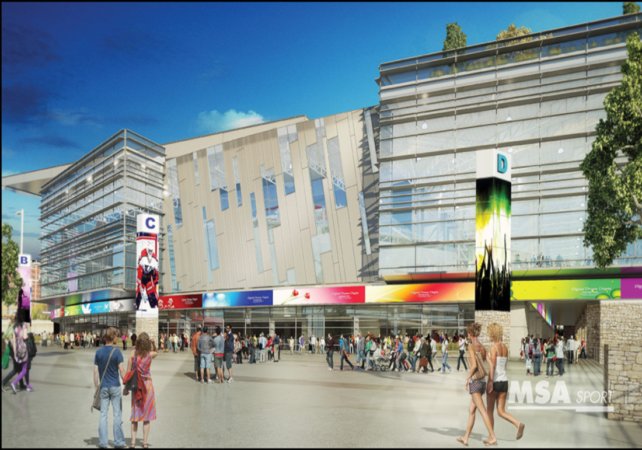
Privately Driven Public-Private Partnerships
Project |  | Project Cost |  | Potential Economic Impact |  |  |  | Potential Funding Sources |  | ROI - generated revenues for County Services
FC Cincinnati Stadium |  | $ 200,000,000 (not including site preparation, roads, and other infrastructure) |  | TBD |  |  |  | $100 million – private funding |  | Sales tax Transient occupancy tax Property tax (after potential TIF/incentives expire)
US Bank Arena |  | $ 342,000,000 |  | TBD |  |  |  | TBD |  | Parking revenue Sales tax Transient occupancy tax Property tax (after potential TIF/incentives expire)
Notes:
Source: U.S. Bureau of Labor Statistics Release: Unemployment in States and Local Areas (all other areas) U.S. Bureau of Labor Statistics, Unemployment Rate in Hamilton County, OH [OHHAMI1URN], retrieved from FRED, Federal Reserve Bank of St. Louis; https://fred.stlouisfed.org/series/OHHAMI1URN, January 31, 2017.

Slide 13
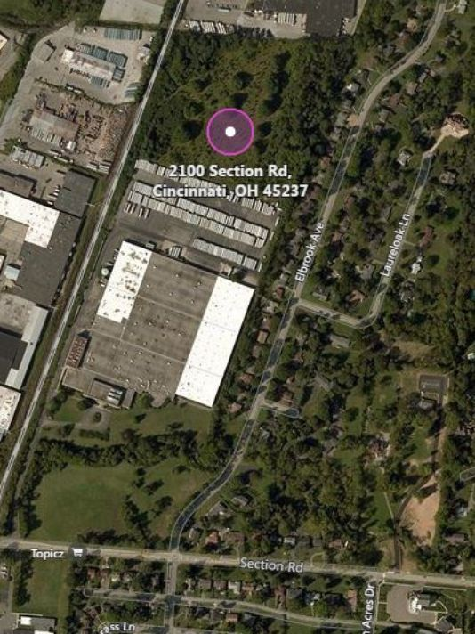
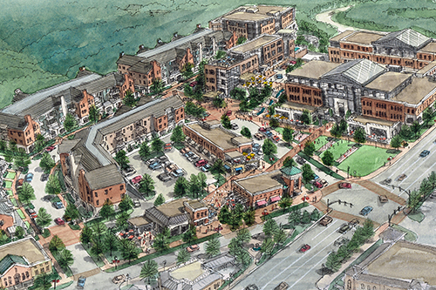
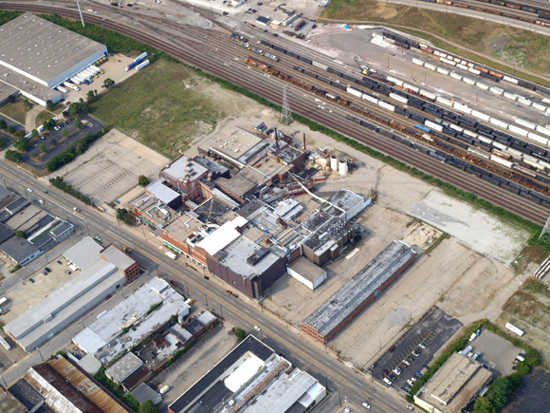
Publicly Driven Public-Private Partnerships
Project | Project Cost |  | Potential Economic Impact |  |  |  | Potential Funding Sources |  | ROI - generated revenues for County Services
AeroHub / GE Evendale | $ 240,000,000 |  | TBD |  |  |  | State; local investment - TIF Revenues |  | Sales tax TOT Property tax (after potential TIF/ incentives expire)
Montgomery Gateway | $ 100,000,000 |  | TBD |  |  |  | Local investment - TIF Revenues |  | Sales tax Property tax (after potential TIF/ incentives expire
Cincinnati Gardens | $ 1,750,000 |  | $ 20,500,000 |  |  |  | Port of Greater Cincinnati Development Authority purchased site for $1.75 million |  | Sales tax; Property tax (after potential TIF/ incentives expire
Gibson Greeting Card | $ 12,800,000 |  | $ 44,800,000 |  |  |  | Port of Greater Cincinnati Development Authority – $8.5 million; JobsOhio - $2.3 million; County - $2.0 million |  | Sales tax; Property tax (after potential TIF/ incentives expire)
Sara Lee / Kahn's | TBD |  | TBD |  |  |  | Hamilton County and Port of Greater Cincinnati Development Authority awarded $3.0 million Clean Ohio grant; City of Cincinnati committed $400,000 for demolition |  | Sales tax; Property tax (after potential TIF/ incentives expire)
Notes:
No pictures or general reference to these projects, but left in case you want to speak to them

Slide 14
Transportation Initiatives
Project |  | Project Cost |  | Potential Economic Impact |  |  |  | Potential Funding Sources |  | ROI - generated revenues for County Services
Brent Spence Bridge |  | $ 2,700,000,000 |  | TBD |  |  |  | Federal and state grants and funds: TIFIA, TIGER, OKI, ODOT; local license tax fee; private funding through a P3; possible tolls
Intermodal Transit System |  | $ 48,000,000 |  | TBD
OKI Regional Freight Plan
Hamilton County Policy Initiatives (TID) * Corridors of Opportunity * Legislative Priorities and Supplemental Projects
Multi-State Transportation Initiatives
Notes:
No pictures or separate slide but left in case you want to speak to these initiatives. Release: Unemployment in States and Local Areas (all other areas) U.S. Bureau of Labor Statistics, Unemployment Rate in Hamilton County, OH [OHHAMI1URN], retrieved from FRED, Federal Reserve Bank of St. Louis; https://fred.stlouisfed.org/series/OHHAMI1URN, January 31, 2017.

Slide 15
Sales Tax
Current additional capacity: $38 million
Union Terminal tax expires in 2020
Approximately $50 million additional capacity available in 2032 when debt service on stadia and infrastructure expires.

Slide 16
Transient Occupancy Tax
Current reserve: $8 million
Each 1% generates $2.5 million
Current capacity devoted to debt service on Duke Energy Convention Center, Sharonville Convention Center and:
Convention and Visitors Bureau marketing
Community capital grants
Additional capacity would require reprioritization of current revenues, State authorization, or both.

Slide 17
Parking Revenue
$1.2 million additional capacity available with full defeasance of parking revenue bonds in 2026
$1.9 million capacity with retirement of SIB loan in 2019
Parking funds dedicated for enterprise purposes.

Slide 18
Tax Increment Financing
Dependent upon property valuation
Incremental property tax revenues used to finance costs of public infrastructure.
Historic/current/future funding mechanism utilized on The Banks.

Slide 19
Other Potential Funding Sources
Federal/State grants
State Loans/Capital Grants
Federal/State Tax Credits (NMTC, HTC, etc.)
Federal Grants (for transportation TIGER, TIFIA, etc.)
Special Assessment Districts
New Community Authority (ORC 349)
County Tax Incentives
CRA/Enterprise Zones
Local Community Tax and Revenue Sources
Community Development Block Grants
Private Equity

Slide 20
Speak today, post your comments online
HamiltonCountyOhio.gov
@HamiltonCountyOhio
Thank you!

